Slide 1
Project 1:
Predicting Match in Speed Dating
Tianhao Guan, Kunbo Zhang, Weiyao Li, Chongzhi Li

Slide 2
Content
Introduction
Data Preprocessing
Feature Selection
Multicollinearity
Imbalanced Data
Modeling
Logistic Regression
Decision Tree
XGBoost

Slide 3
Introduction: Predicting Romantic Matches
Dataset source: https://www.kaggle.com/datasets/ulrikthygepedersen/speed-dating?select=speeddating.csv
Our project aims to predict if two people will match using a dataset gathered from experimental speed dating events from 2002-2004.
The dataset includes information from participants who had a four-minute "first date" with every other participant of the opposite sex, and were asked to rate their date on attributes including: Attractiveness, Sincerity, Intelligence, Fun, Ambition, and Shared Interests.
Participants were also asked whether they would like to see their date again and filled out questionnaires on demographics, dating habits, self-perception, beliefs on what others find valuable in a mate, and lifestyle information.

Slide 4
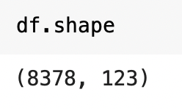
Data Preprocessing: Feature Selection
Considering that our dataset comprises 123 columns, we will need to narrow down the selection to only those attributes that are meaningful in predicting whether a date will result in a match or not.
We need to select the significant features based on common knowledge and quantified feature importance results:
Common Knowledge: manually dropping columns by looking at each columns
Quantified: use feature selection model for each model we perform on the dataset to select optimal number of features

Slide 5
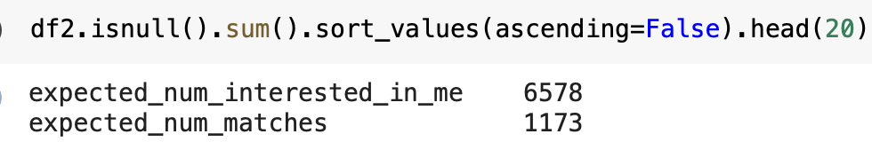
Data Preprocessing: Feature Selection and Missing value
The top two columns with the most missing data are:
expected_num_interested_in_me : Out of the 20 people you will meet, how many do you expect will be interested in dating you?
expected_num_matches: How many matches do you expect to get?
Decided to drop the two columns based on following reasons:
These two variables are not essential for our predictive analysis intuitively
Substituting the missing values with the median or mean could lead to misleading results, and dropping all of the null values was not a feasible solution since we only have 8378 rows.

Slide 6
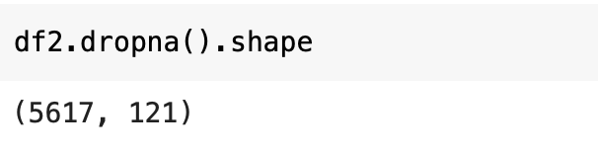
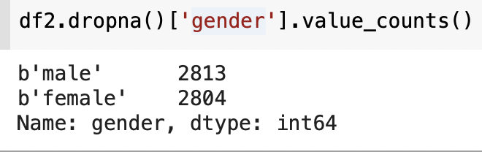
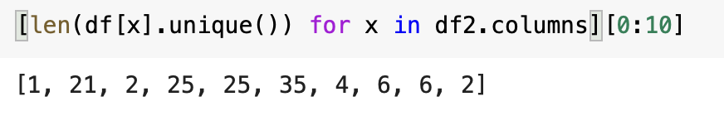
Data Preprocessing: Feature Selection and Missing value
Dropped the rows with missing values with 5617 rows left, since filling out na values with mean or median can potentially introduce bias and deviate from the true values,
and the distribution of variable gender is very balanced
Dropped the first column as it contains only a single unique value

Slide 7
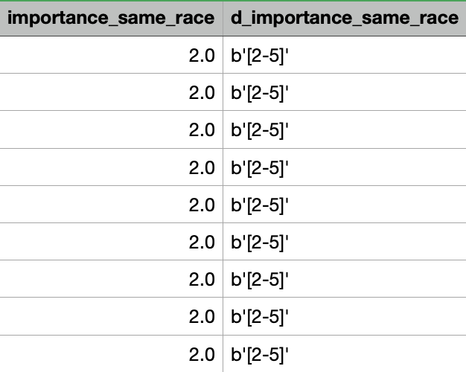
Data Preprocessing: Multicollinearity
We found that for all columns that starts with "d_", they represent the binned range of previous numeric variables.
E.g., column 'd_importance_same_race' would be the binned categorical variable corresponding to the numeric variable 'importance_same_race'.
These can be seen as duplicates of previous columns, meaning that they are perfectly collinear with their corresponding numeric columns. Therefore, we have to drop these columns.
E.g.
Column 'd_importance_same_race' represents the binned categorical variable for the numeric variable 'importance_same_race'.

Slide 8
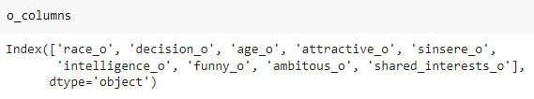
Data Preprocessing: Multicollinearity
We also found that for columns that ends with '_ o' or has '_ o _' in the middle of the column name, they represent the features of the opposite side in the date, i.e., the partner.
However, we noticed that both sides were included.
For the features and the corresponding partner features, the distribution were almost identical, meaning they have nearly the same mean and standard deviation.
Therefore, we have to drop these columns
E.g.
‘age’ and ‘age_o’ represent the person’s age and age of their partner respectively
'age' has a mean of 26.35 and a standard deviation of 3.5668,
while 'age_o' has a mean of 26.36 and a standard deviation of 3.5636

Slide 9
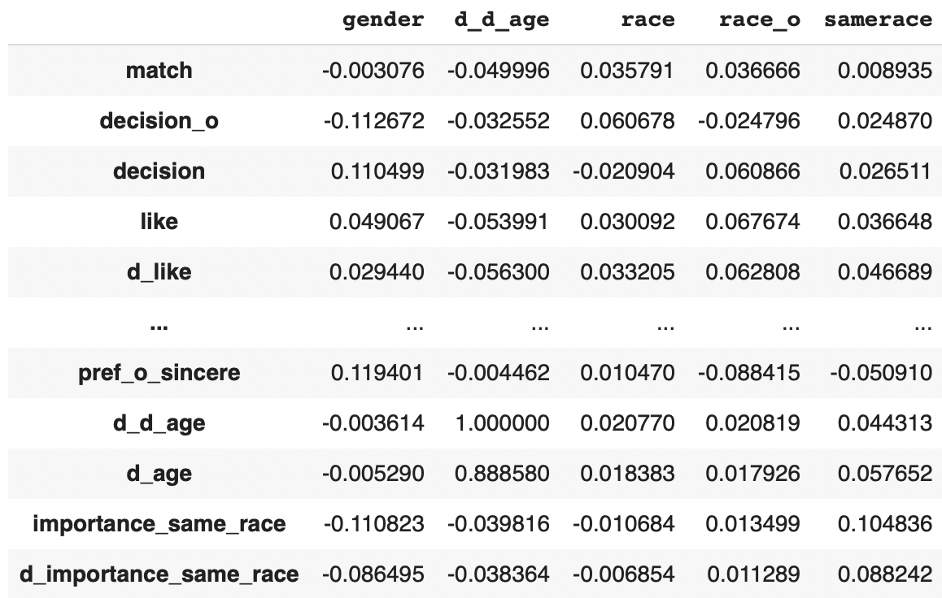
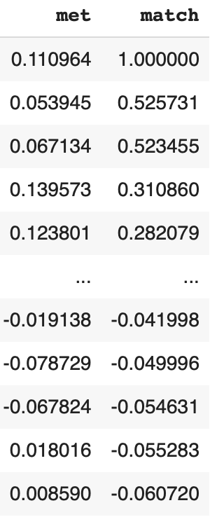
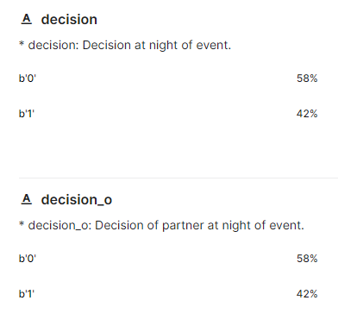
Data Preprocessing: Multicollinearity
While checking correlations between x columns and y column, we found the two variables with highest correlation, ‘decision’ and ‘decision_o’ , are very similar to the target variable match
If decision is 1, and the partner decision_o is also 1, then match=1
Otherwise, match is 0
Problematic because of data leakage (y appearing in x columns).

Slide 10
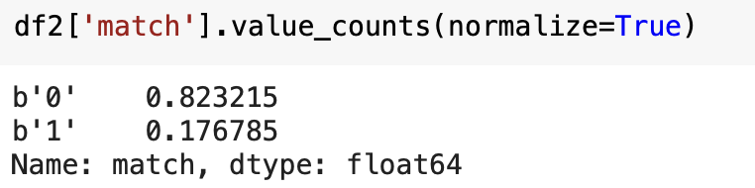
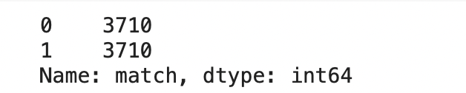
Data Preprocessing: Imbalanced Data
The dataset appears to be imbalanced, with a higher number of unmatches than matches.
To address the issue of overfitting and misleading accuracy, we used the SMOTE algorithm to randomly oversample the minority class. The sample size for both unmatches and matches in the training dataset is the same now.

Slide 11
Modeling
Logistic Regression
Decision Tree
XGBoost
Support Vector Machine (attempted)

Slide 12
Modelling pipeline
Feature Selection -> Recursive Feature Selection (scoring=roc_auc)
Hyperparameter Tuning -> Grid Search

Slide 13
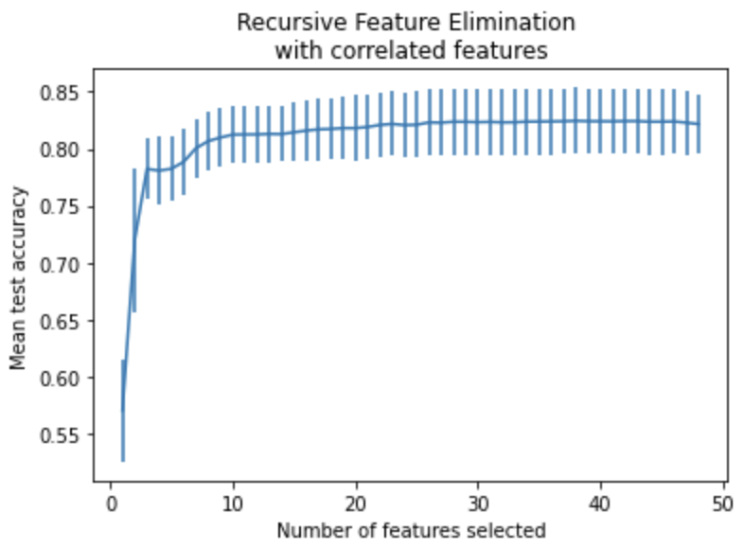
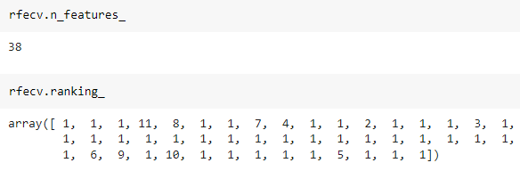
Logistic Regression - Recursive Feature Selection
Left is the graph of number of features vs. mean test accuracy
Optimal number of features is 38
Below is the ranking of each feature ranked by feature importances. 1’s are the features selected

Slide 14
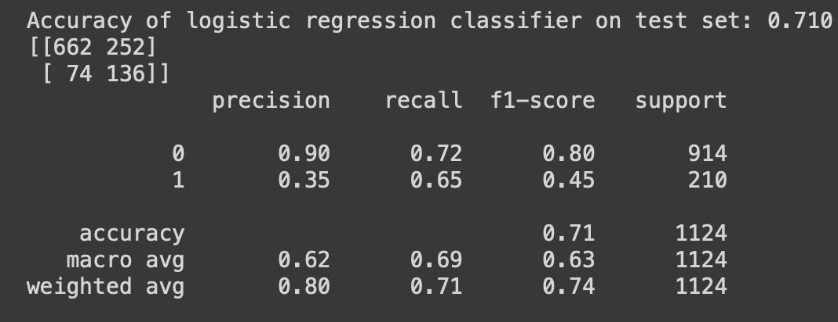
Logistic Regression - Grid Search and Output
Training Dataset Classifier Best Accuracy -> 0.825
Test Dataset Classifier Accuracy -> 0.710

Slide 15
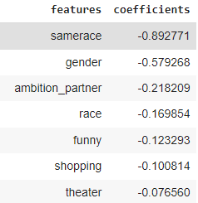
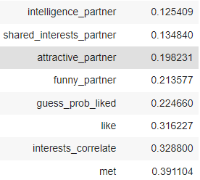
Logistic Regression - Coefficients
Coefficients contribute positively or negatively to the chance that the two people will match
Variable “funny” is rating yourself being funny while “funny_partner” is rating your partner on how funny you think he/she is.
Interestingly, “funny_partner” has a positive coef while “funny” has a negative coef. This means that it’s important for your partner to consider you as funny in a date, rather than considering yourself funny (and that might have the opposite effect)
Other variables including “attractive_partner” (rate your partner on attractiveness), “interests_correlate” (interests correlation) all have a positive effect on match, which is reasonable
The variable with the highest positive coef is “met” (whether have met before), which says a lot in a date.
Need to get to know each other and become familiar

Slide 16
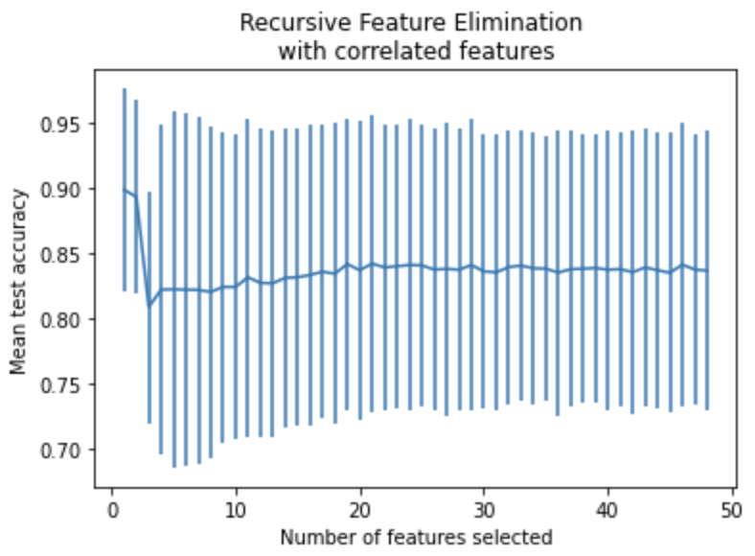

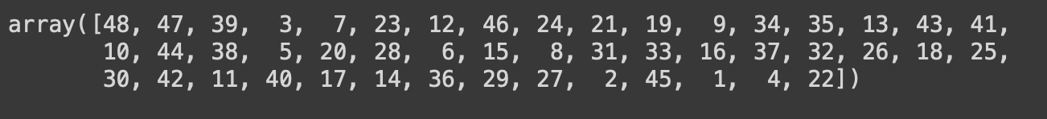
Decision Tree - Recursive Feature Selection
Without setting minimum features, our feature selection chose the optimal number of features to be 1. The variable is “like” (whether liked your partner or not)
Guess that’s all it matters at the end of the day, according to decision tree
However, we want to build a model where we can input several features, not just one feature
what if in reality the feature 'like' is missing this time
We need to specify the minimum number of features to be chosen

Slide 17
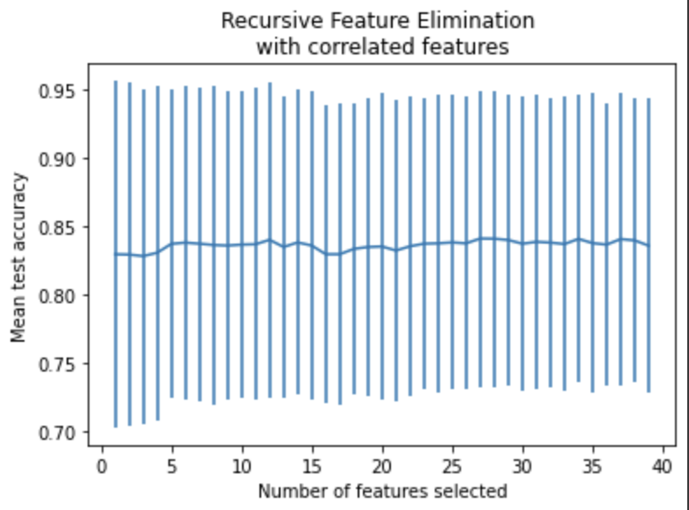
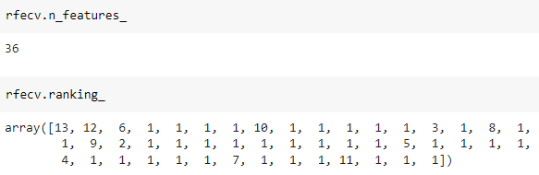
Decision Tree - Recursive Feature Selection(adjusted)
Setting the minimum number of features to be 10, we get optimal number of features=36

Slide 18
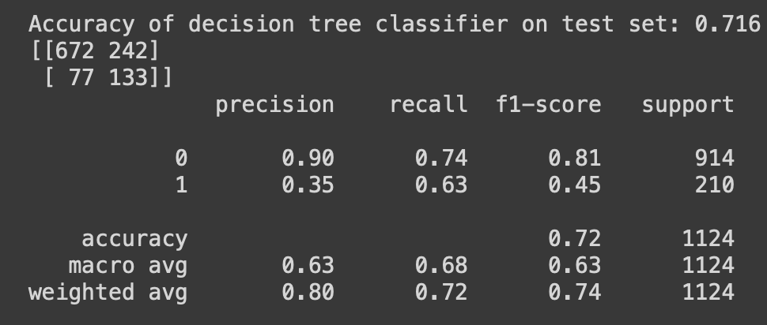
Decision Tree - Grid Search
Training Dataset Best Accuracy -> 0.883
Test Dataset Accuracy -> 0.716

Slide 19
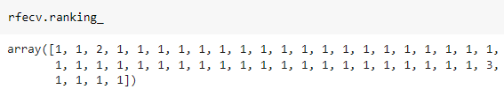
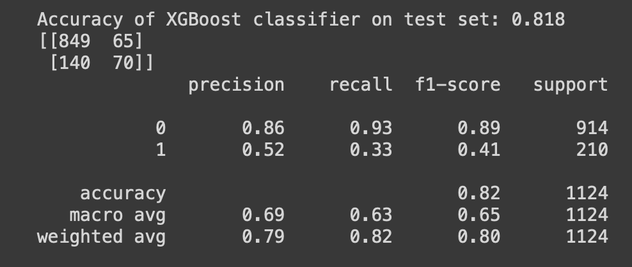
XGBoost
For XGBoost, nearly all features were selected
Training Dataset Best Accuracy -> 0.971
Test Dataset Accuracy -> 0.818

Slide 20
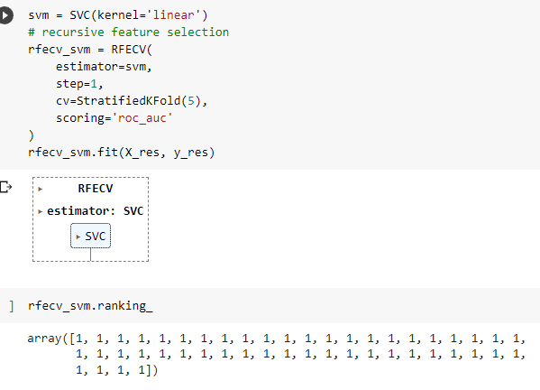
Support Vector Machine
We tried to use SVM and the same pipeline
Specified kernel=’linear’ in feature selection because the default parameter does not have coefficients or feature importances required by recursive feature selection
The GridSearch step took way too long to run (8 hours and failed)

Slide 21
Comparing different models
XGBoost does have the overall highest accuracy (0.818), but our test set is imbalanced, so we cannot just look at the accuracy.
XGBoost has the lowest recall among all three models (0.33). This means that if we prioritize the true positive rate (out of all the true positives, how many did we predict to be positive), we might want to choose logistic regression model which has the highest recall (0.65)
However, XGBoost does have the highest precision (0.52), meaning that it has the highest proportion of true positives in all of the predicted positives.
Overall, our model did well in predicting the 0’s, the unmatched, but not very good in predicting the 1’s, the matched. Again, this is due to our test target variable is very imbalanced, and accuracy alone in this case can be misleading.

Slide 22
Potential Improvements
If we had more time, we probably could have successfully ran the SVM model and we would have one more model to compare and choose from
We could also try out more parameters (different scoring) and other feature selection models
If we had more data, we could probably solve the class imbalance problem in the test set and obtain more meaningful results

